Slide 1
Swing
Layout Manager
Nguyễn Văn Khiết

Slide 2
Content
Introduction to Layout Manager
Java layout managers

Slide 3
Introduction to Layout Manager
Layout manager arranges components within the container.
When the size of the container changes the size and arrangement of the components also changes in response

Slide 4
Java layout managers
BorderLayout
BoxLayout
CardLayout
FlowLayout
GridLayout
GridBagLayout
SpringLayout
GroupLayout
Null Layout

Slide 5
FlowLayout
The FlowLayout class puts components in a row, sized at their preferred size.
If the horizontal space in the container is too small to put all the components in one row, the FlowLayout class uses multiple rows.
The row of components, by default, centered horizontally within the container.

Slide 6
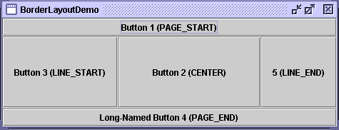
BorderLayout
BorderLayout object has five areas: top, bottom, left, right, center.
If the window is enlarged, the center area gets as much of the available space as possible

Slide 7
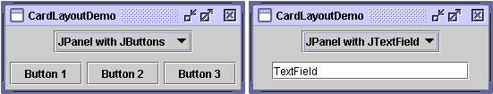
CardLayout
The CardLayout class manages two or more components (usually JPanel instances) that share the same display space.

Slide 8
CardLayout
CardLayout methods:
  void first(Container);
  void next(Container);
  void previous(Container);
  void last(Container);
  void show(Container, String);

Slide 9
GridLayout
A GridLayout object places components in a grid of cells.
The container will be divided into rows and columns:
  Each component takes all the available space within its cell
  Each cell is exactly the same size

Slide 10
GridLayout
GridLayout constructors
  public GridLayout(int rows, int columns)
  public GridLayout(int rows, int columns, int horizontalGap, int verticalGap)

Slide 11
GridBagLayout
A GridBagLayout places components in a grid of rows and columns,
  allowing specified components to span multiple rows or columns.
  Not all rows necessarily have the same height. Similarly, not all columns necessarily have the same width
GridBagLayout is one of the most flexible and complex layout managers.

Slide 12
GridBagLayout
The way the program specifies the size and position characteristics of its components is by specifying constraints for each component.
To set constraints on a component: passing it a GridBagConstraints object.

Slide 13
GridBagLayout
GridBagConstraints properties:
  gridx, gridy
  gridwidth, gridheight
  fill
  ipadx, ipady
  insets
  anchor
  weightx, weighty

Slide 14
BoxLayout
BoxLayout either stacks its components on top of each other or places them in a row.
As the box layout arranges components, it takes the components' alignments and minimum, preferred, and maximum sizes into account.

Slide 15
BoxLayout
For a top-to-bottom box layout, X Alignment affect location of the components (as a group) within their container
Values of X Alignment from 0.0 to 1.0.
    0.0 ←→Component.LEFT_ALIGNMENT
    0.5 ←→ Component.CENTER_ALIGNMENT
    1.0 ←→ Component.RIGHT_ALIGNMENT.

Slide 16
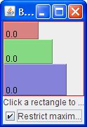
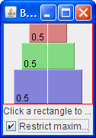
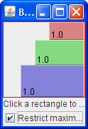
BoxLayout
X Alignment examples:

Slide 17
BoxLayout
Invisible Components
  Rigid area
  HorizontalGlue
  VerticalGlue
  Filler

Slide 18
SpringLayout
Spring layouts do their job by defining directional relationships, or constraints, between the edges of components.
The springs associated with each component are collected into a SpringLayout.Constraints object.
A SpringLayout can be visualized as a set of objects that are connected by a set of springs on their edges.

Slide 19
GroupLayout
GroupLayout is a layout manager that was developed for GUI builders.
GroupLayout uses two types of arrangements - sequential and parallel, combined with hierarchical composition.

Slide 20
Null Layout
No layout manager applied.
Set absolute position for components.

